Slide 1

Visualizing and Understanding Convolutional Networks
Team: Alterant
Alefiah Mubeen (20172146)
Ankita Maity (2021701017)
Seshadri Mazumder (2021801002)
Vivek Pareek (2021701001)
Course Name : Statistical methods in AI
Course ID : CS7.403.M21
Instructors : Dr. Anoop Namboodiri Assigned TA : Yashas Samaga
Github Repo: Github link

Slide 2
Index
Sl No | Topic | Sl No | Topic
1. | Introduction | 8. | Quantitative Evaluation of results
2. | Problem Statement | 9. | Architecture-2
3. | Objectives | 10. | Image Creation to Maximize Class Scores
4. | Architecture - 1 | 11. | Heat Map Generation for Occlusion
5. | Feature Visualisation | 12. | Conclusions and Future Works
6. | Feature Visualisation for Affine Transformations | 13. | References
7. | Feature Visualisation for Occlusional Sensitivity | 14. | Work Division

Slide 3
Introduction
CNNs have been used for a wide variety of tasks, and using them leads to excellent performance in many benchmarks.
There is little understanding of why these models perform as well as they do.
We implement papers that provide visualisation techniques why large CNN’s perform well.
We perform Affine Transformations and Occlude parts of image to understand which portions of image are important for classification.

Slide 4
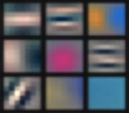
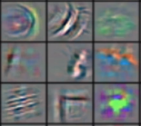
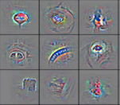
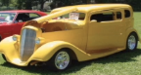
Problem Statement
Given an image our task is to visualise the layers of large CNN’s that attend to different features of the image.
Input Image
Lower Layers
Upper Layers

Slide 5
Objectives
First we have complete the two end-to-end pipelines.
The pipelines we have created for VGG-16, VGG-19.
As part of feature inversion we are reconstructing images from different layers of VGG-16, and VGG-19.
As part of occlusion, we experiment by masking a part of the image before feeding it to the CNN, and we visualise the features after inversion in the image space.
We perform experiments with different data augmentation based on affine transformations like rotation, and translation to study feature invariance.

Slide 6
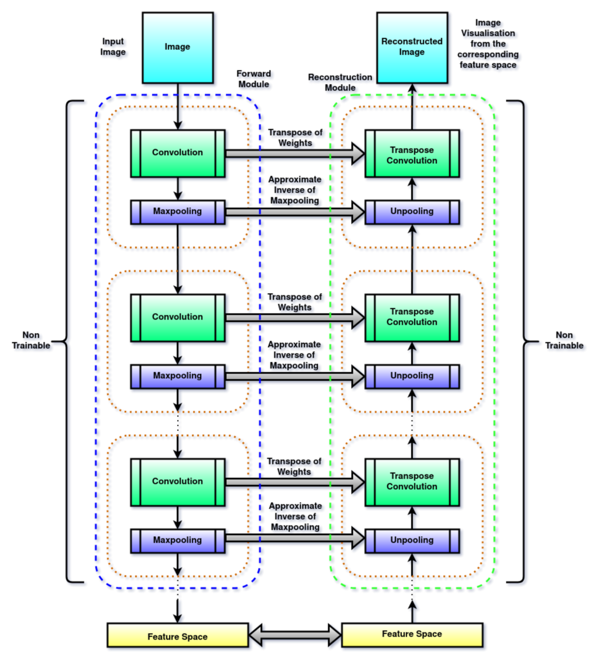
Architecture 1
Input : Image
Output : Reconstructed Image of feature map from each layer
Left part of the architecture corresponds to VGG-16 / VGG-19
Right part of the architecture represents the corresponding layers inverted i.e.,
Convolution -> Transpose Convolution
Maxpooling -> Unpooling

Slide 7
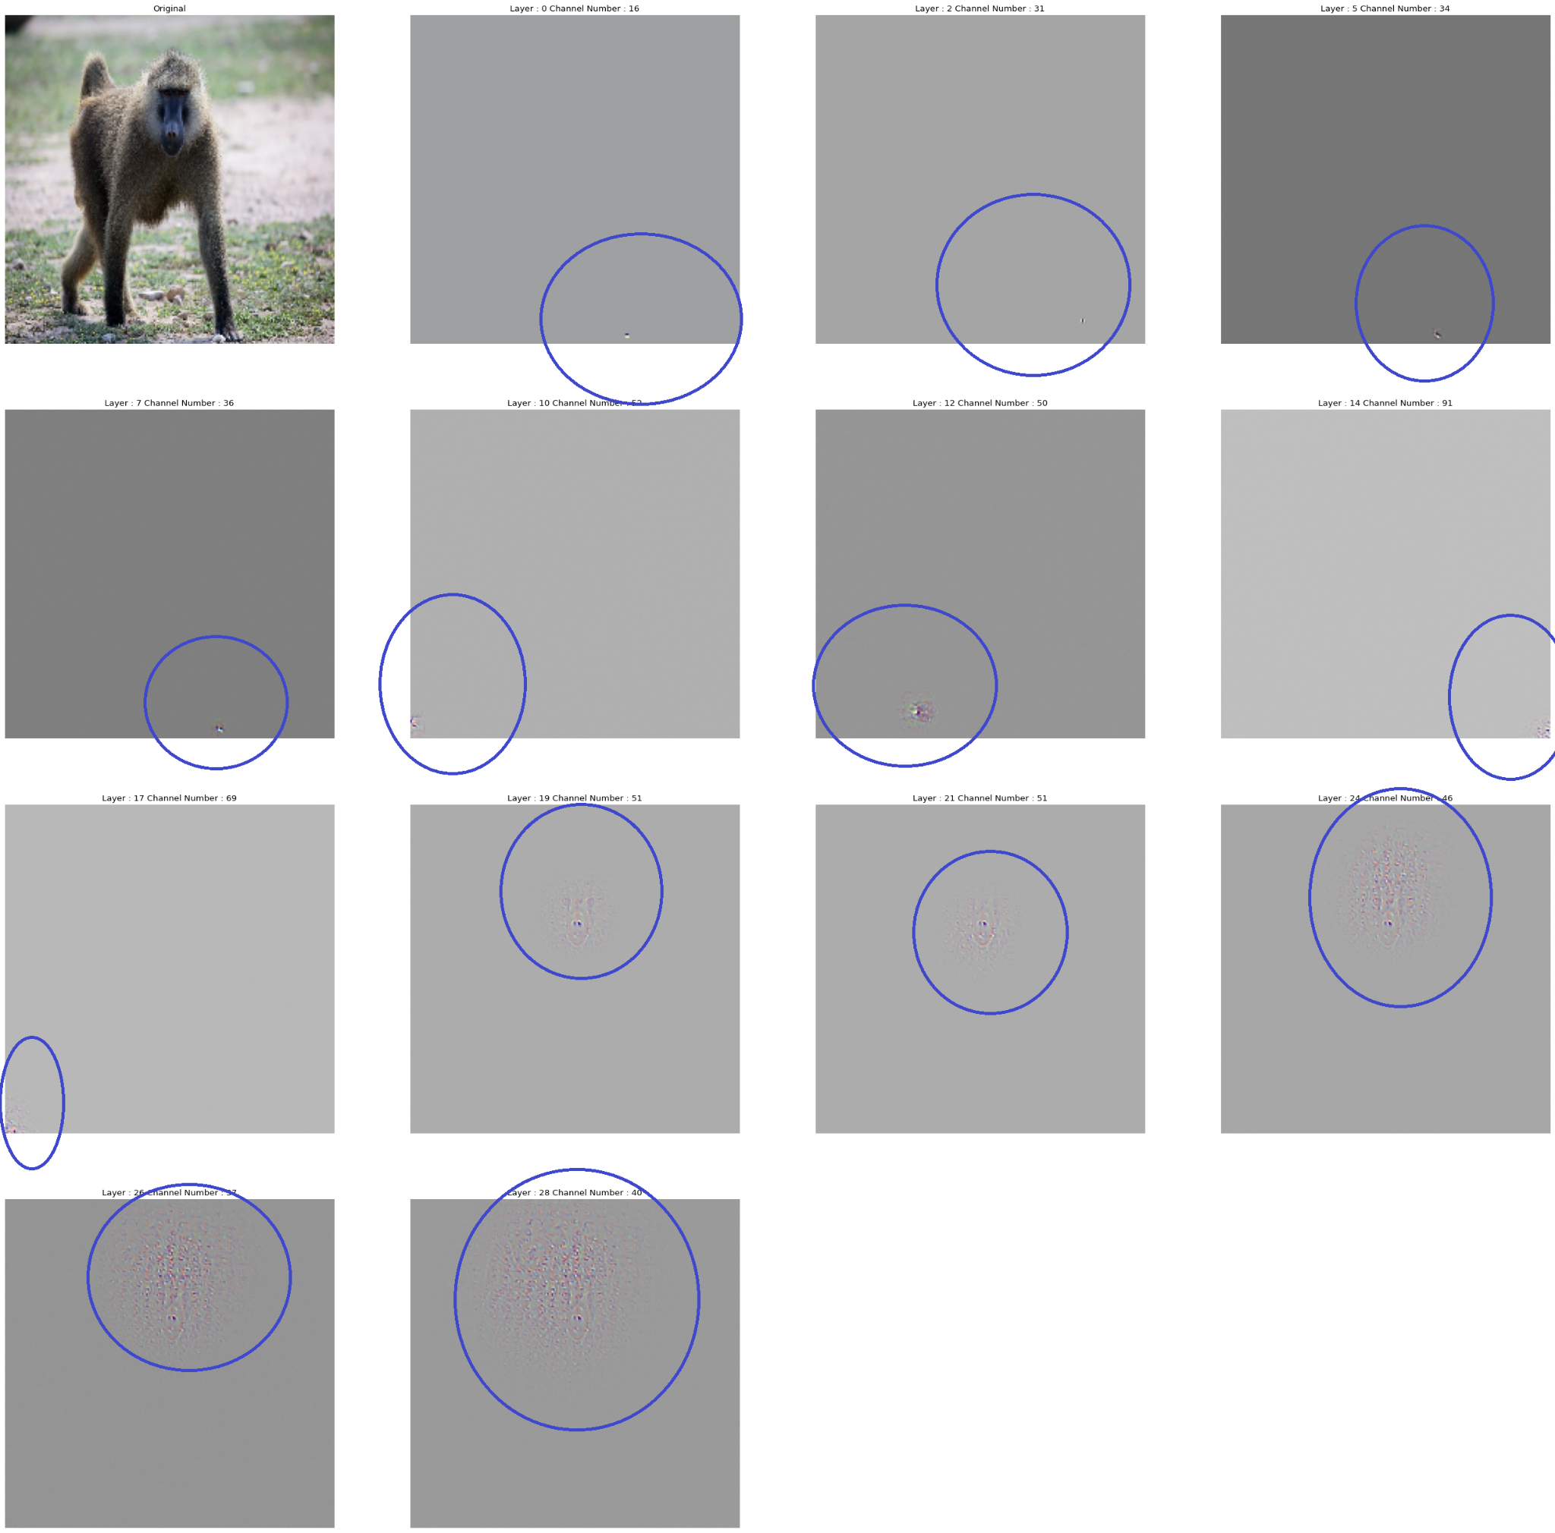
Feature Visualisation (Baboon)

Slide 8
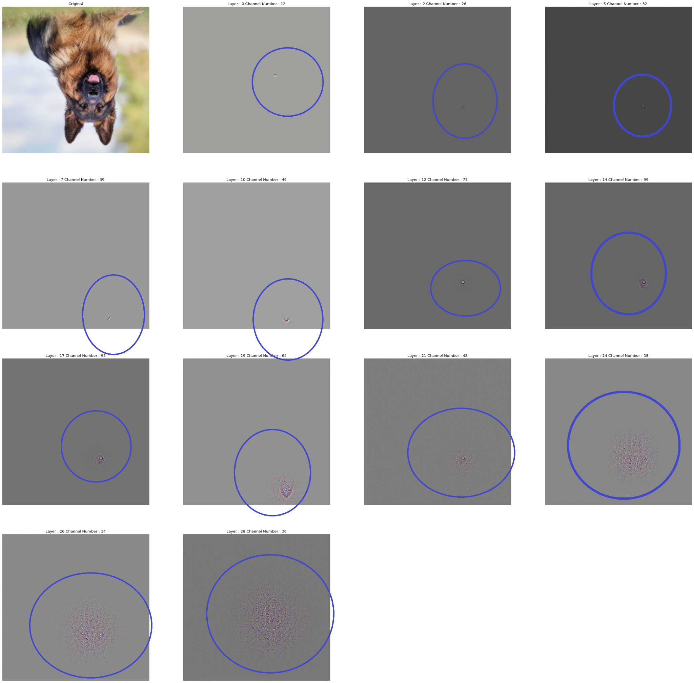
Feature Visualisation for Affine Transformations
Dog Rotated by 180 degree counterclockwise

Slide 9
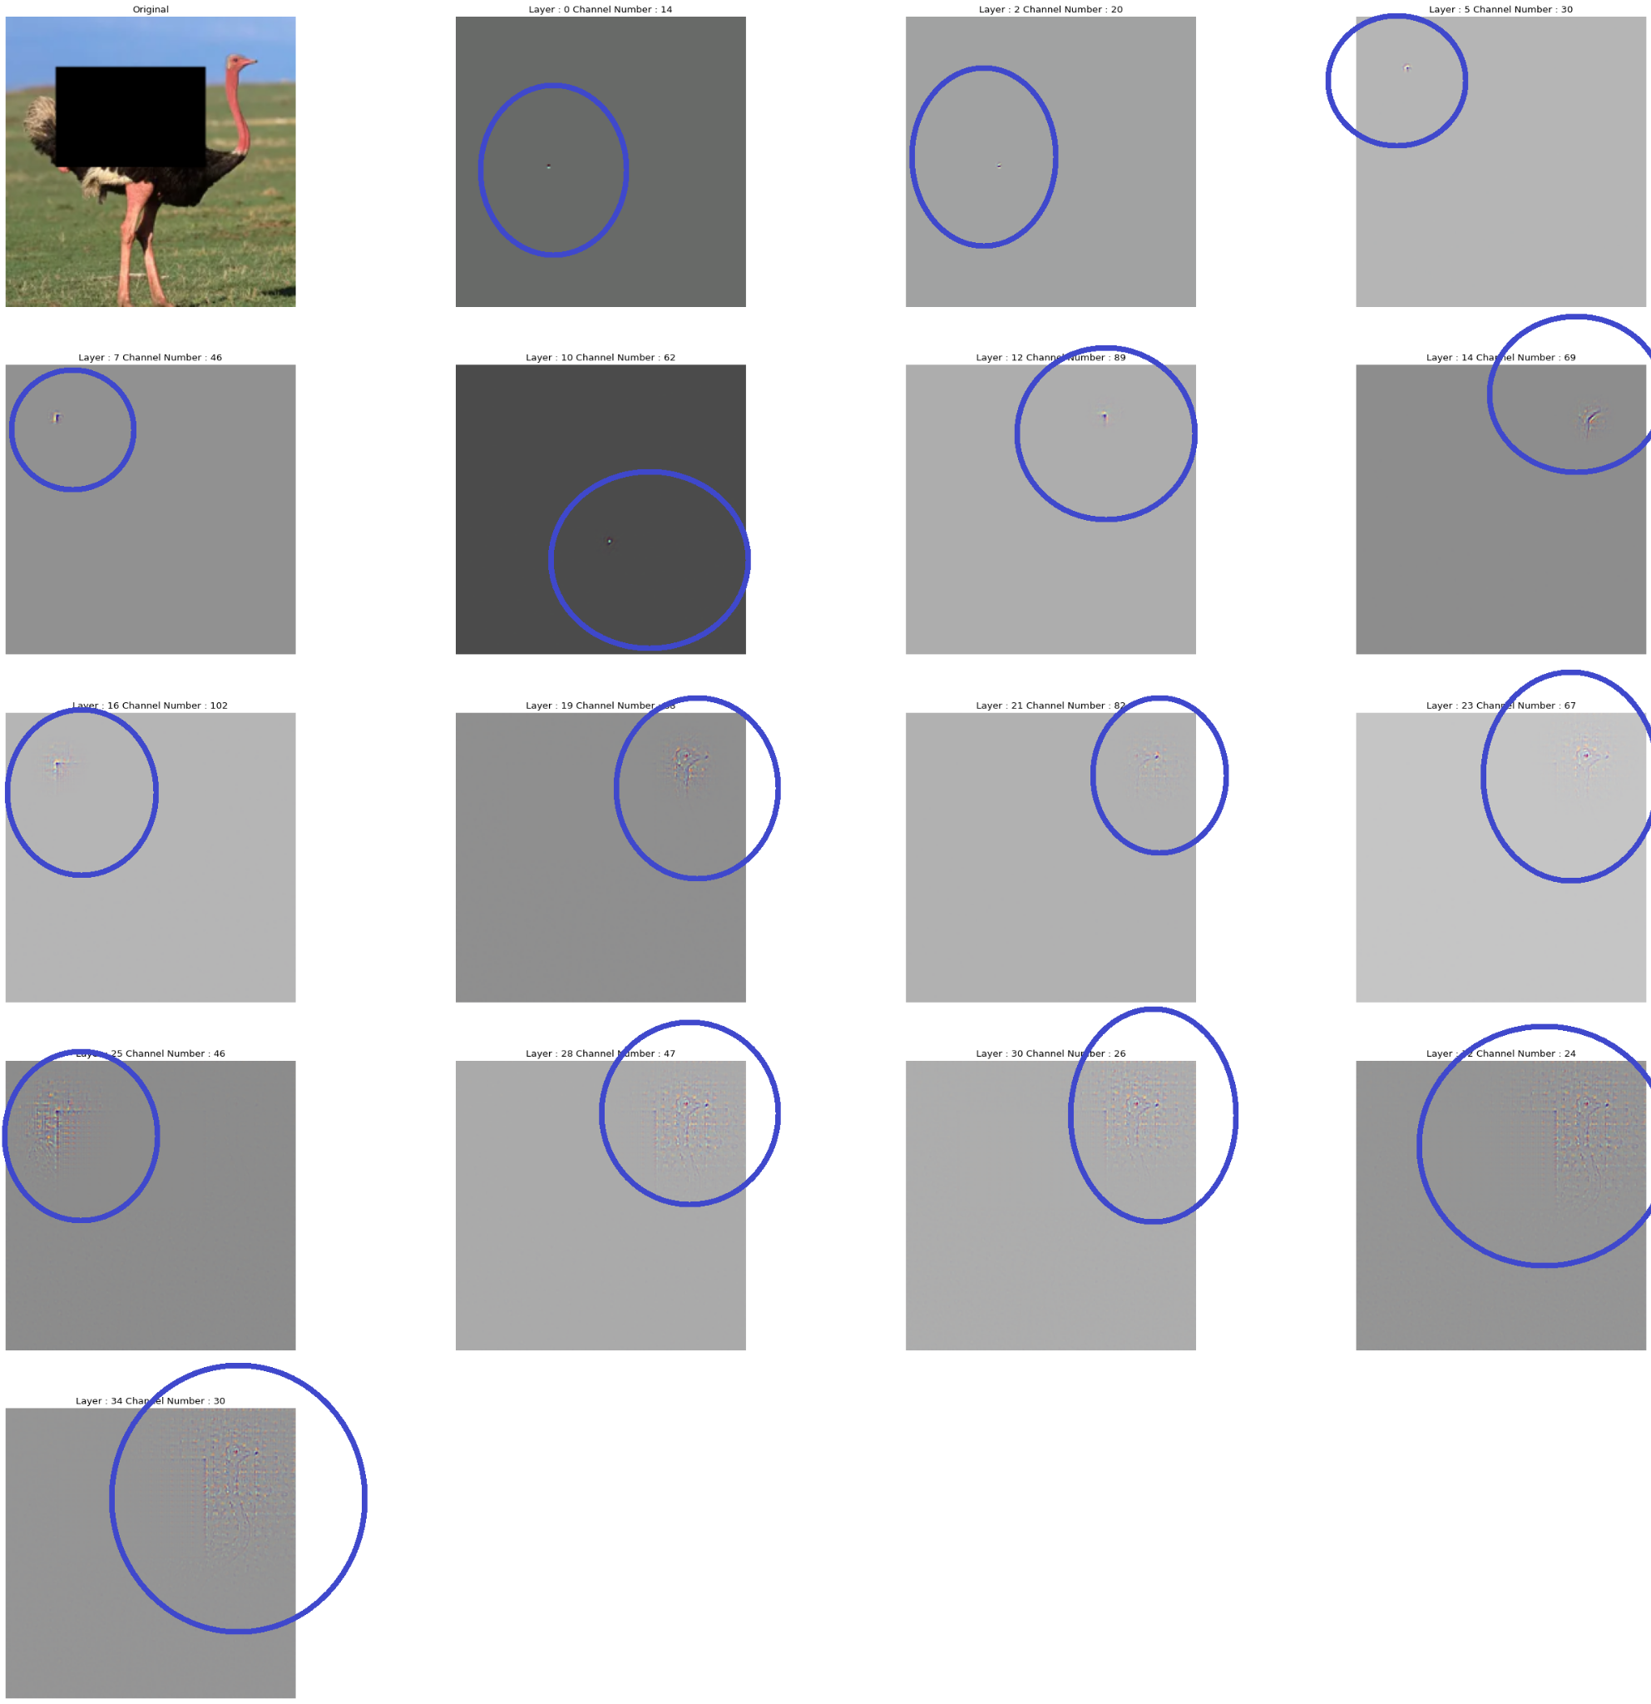
Feature Visualisation for Occlusional Sensitivity
Center Occlusion

Slide 10
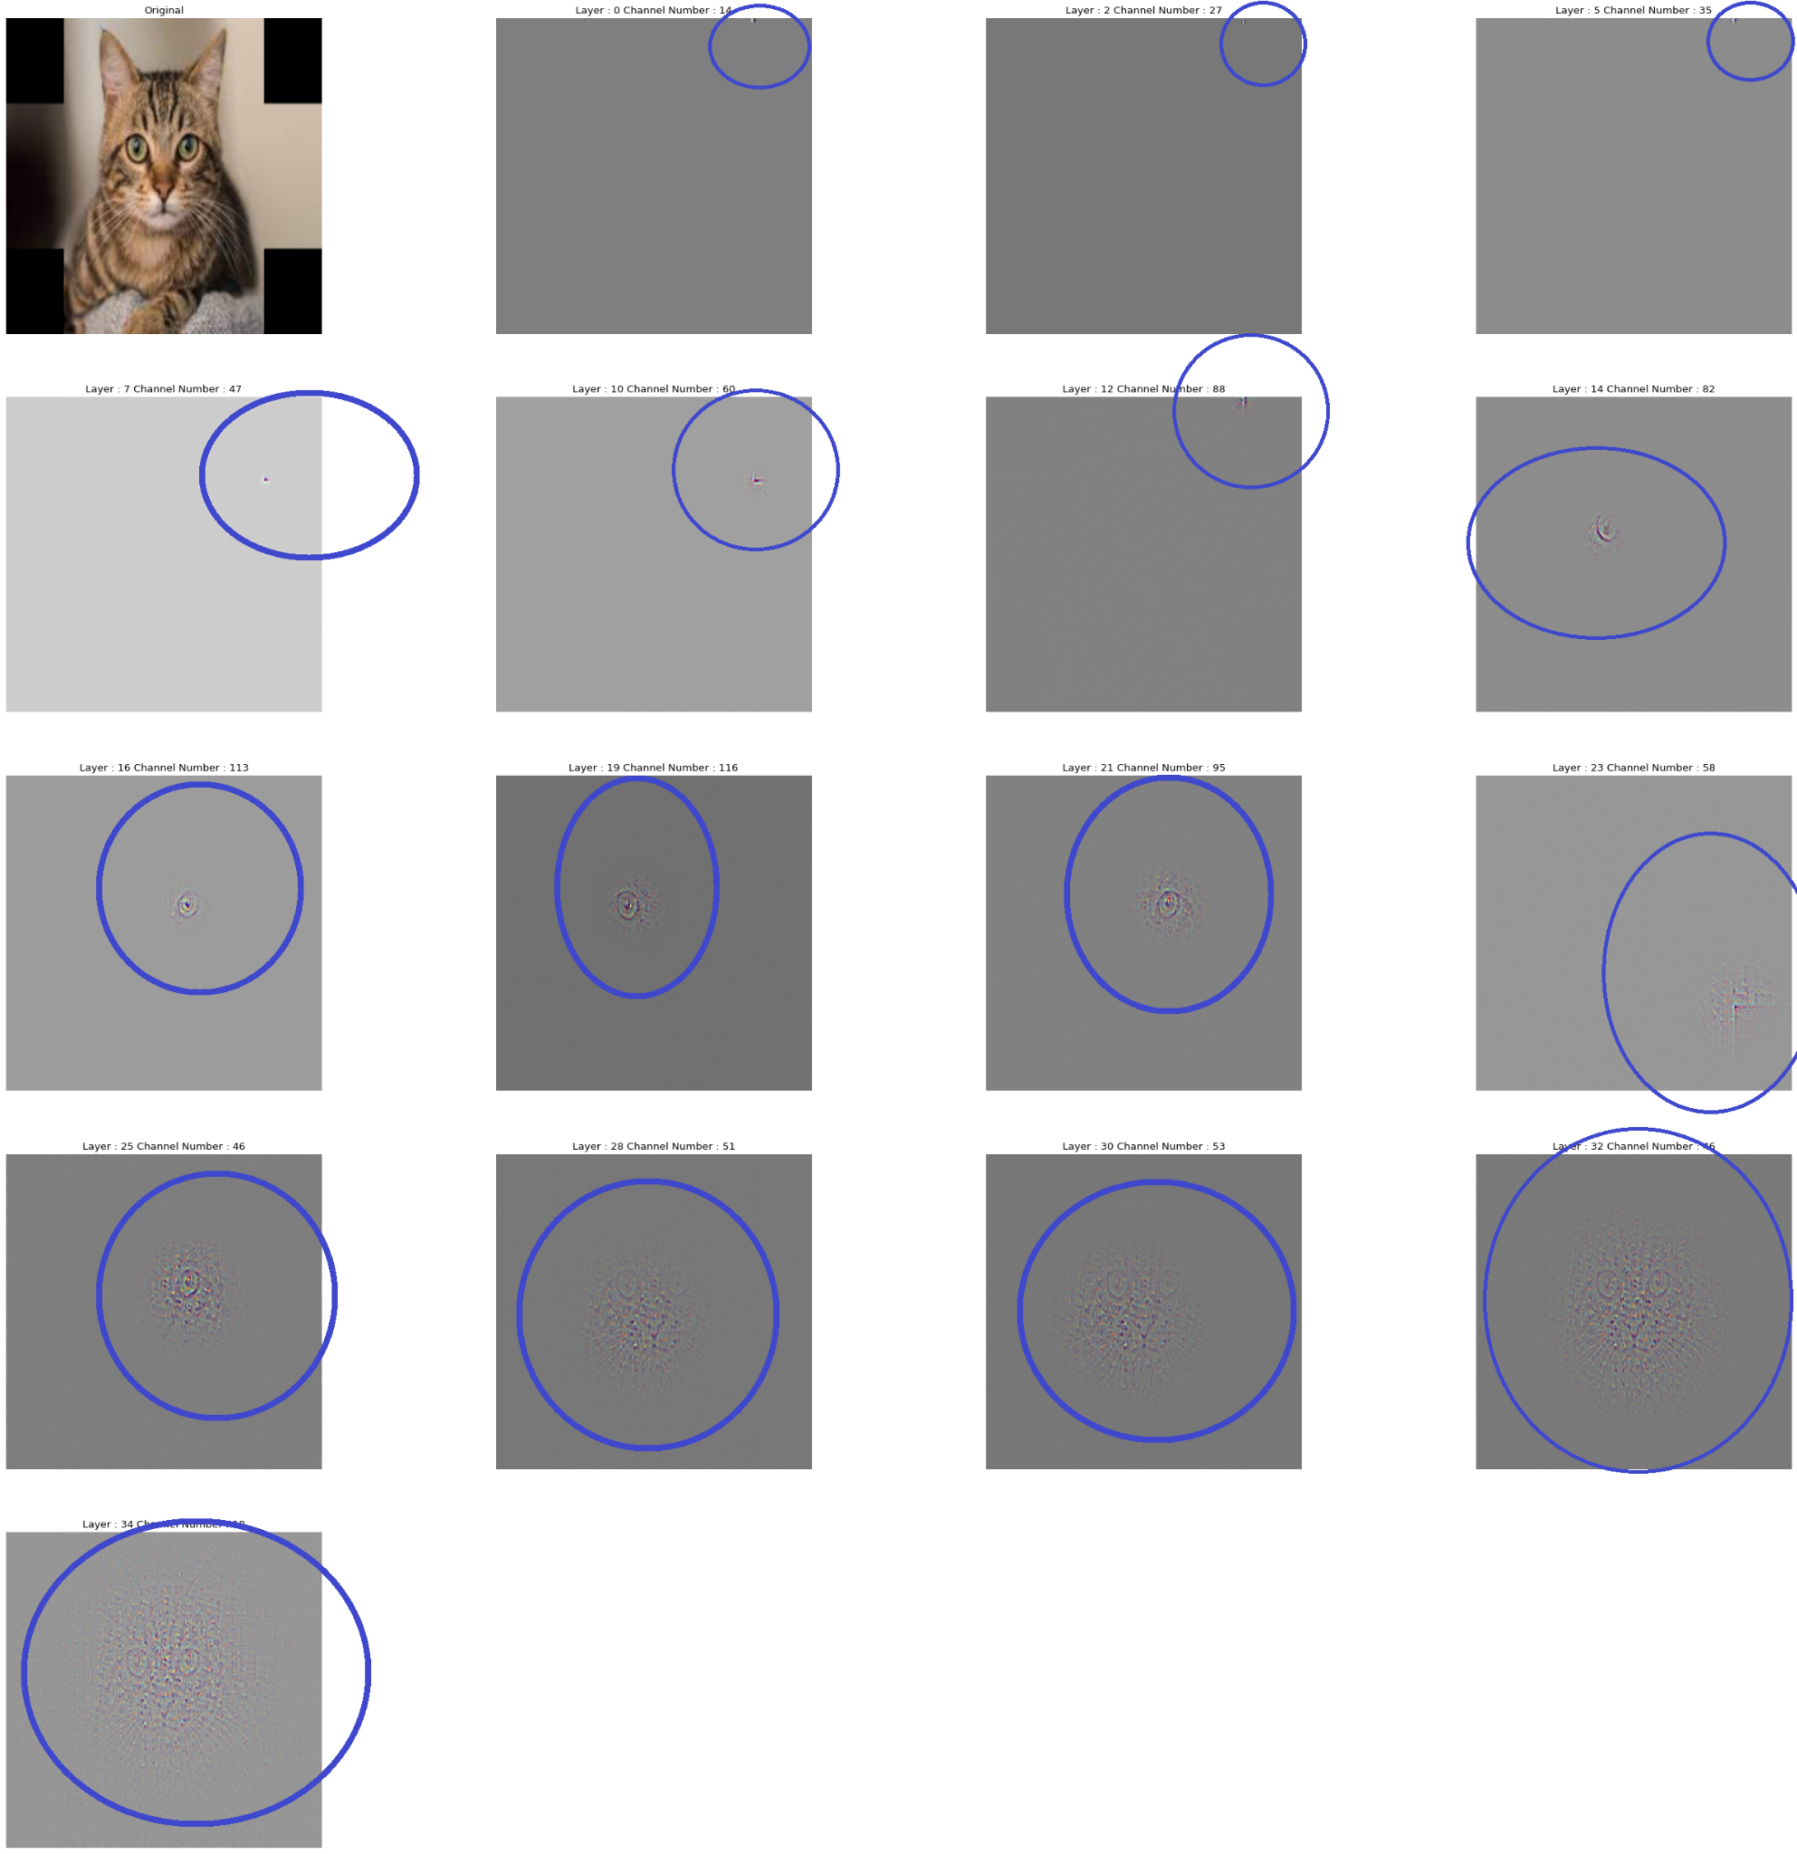
Feature Visualisation for Occlusional Sensitivity
Corner Occlusion

Slide 11
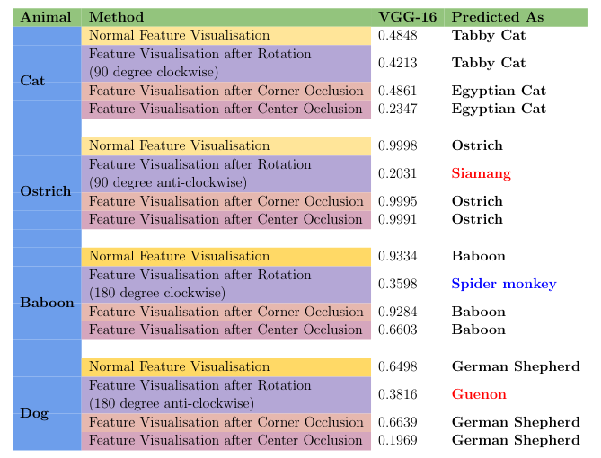
Quantitative Evaluation
VGG-16

Slide 12
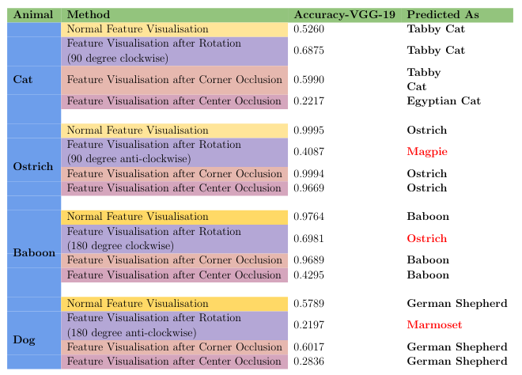
Quantitative Evaluation
VGG-19

Slide 13
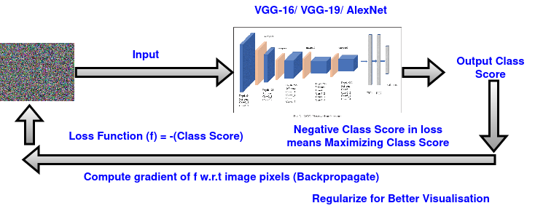
Architecture 2

Slide 14
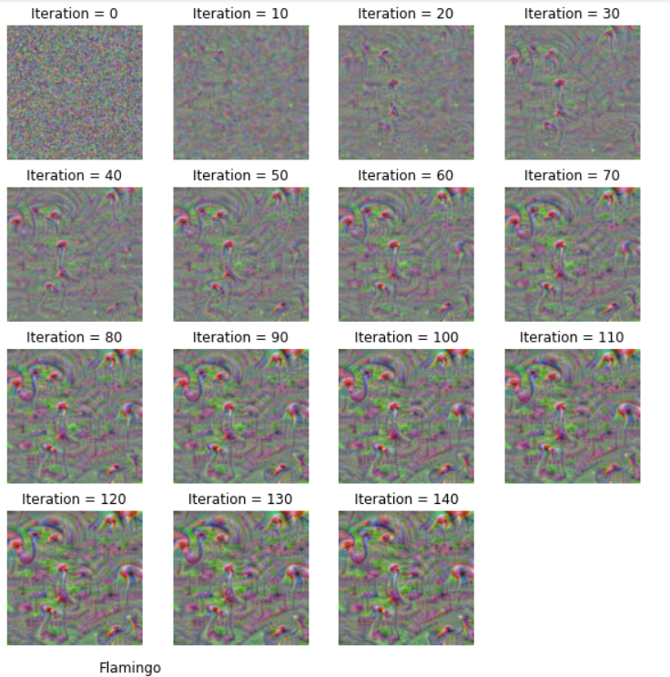
Image Creation to Maximize class scores
Flamingo

Slide 15
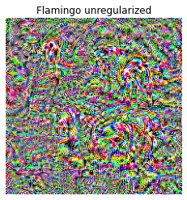
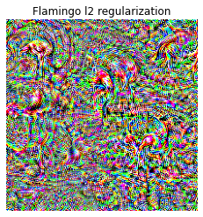
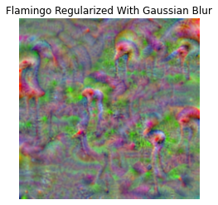
Unregularized vs l2 Regularization vs Adding Gaussian Blur

Slide 16
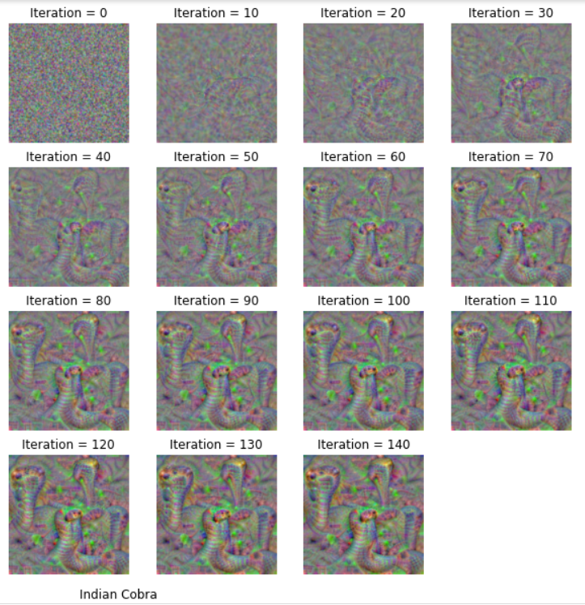
Image Creation to Maximize class scores
Indian Cobra

Slide 17
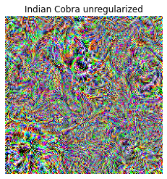
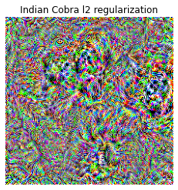
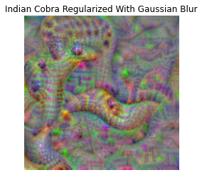
Unregularized vs l2 Regularization vs Adding Gaussian Blur

Slide 18
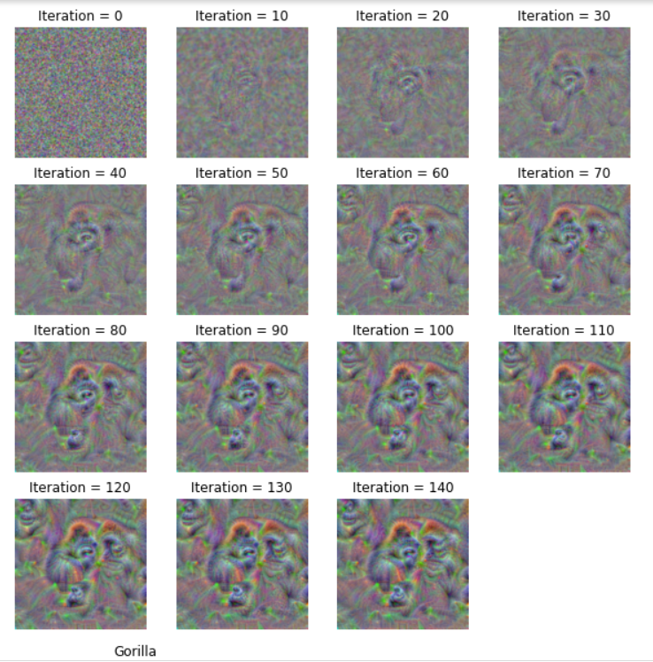
Image Creation to Maximize class scores
Gorilla

Slide 19
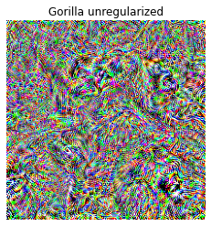
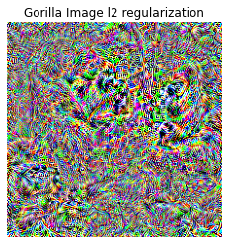
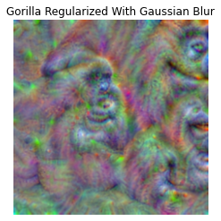
Unregularized vs l2 Regularization vs Adding Gaussian Blur

Slide 20
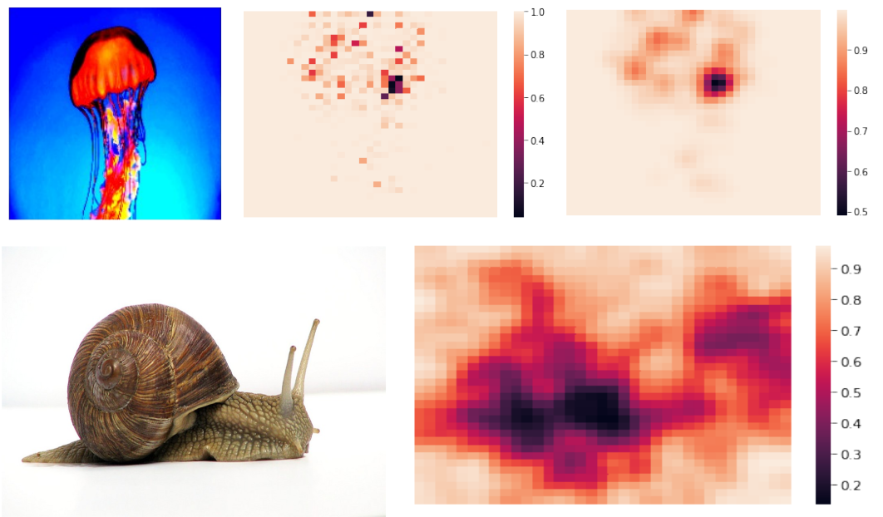
Heatmap Generation using Occlusion Sensitivity

Slide 21
Conclusion & Future Works
We experimented on two architectures for Feature Visualisations
In the first architecture for an input image when passed through the CNN’s, for feature generated from each layer we try to visualise the corresponding maps.
From our visualisation we can easily get that the lower layers of the CNN’s attend to the high frequency features, like corners or edges.
And the upper layers attend to the textures.
We also perform Affine Transformations on images to better understand if the network is rotation invariant to the images and we have discussed the results earlier. We perform similar experiments with occlusion too.
In the second architecture which makes visualisation for class specific attributes.
Starting with an Gaussian Noise we train the architecture to minimize the loss that maximize the class specific scores.
We have also attended Heat-maps for better understanding of the feature maps.
We faced challenges due to low computation speed in Colab.
Visualising CNN’s with different attention maps still remains a future prospect for us to explore.

Slide 22
References
[1] A. Mahendran and A. Vedaldi, “Understanding deep image representations by inverting them,” pp. 5188–5196, 06 2015.
[2] M. Zeiler and R. Fergus, “Visualizing and understanding convolutional neural networks,” vol. 8689, 11 2013.
[3] K. Simonyan and A. Zisserman, “Very deep convolutional networks for large-scale image recognition,” arXiv 1409.1556, 09 2014.
[4] B. Bermeitinger, S. Donig, M. Christoforaki, A. Freitas, and S. Handschuh, “Vgg19,” 10 2017.
[5] A. Krizhevsky, I. Sutskever, and G. Hinton, “Imagenet classification with deep convolutional neural networks,” Neural Information Processing Systems, vol. 25, 01 2012.
[6] O. Russakovsky, J. Deng, H. Su, J. Krause, S. Satheesh, S. Ma, Z. Huang, A. Karpathy, A. Khosla, M. Bernstein, A. C. Berg, and L. Fei-Fei, “ImageNet Large Scale Visual Recognition Challenge,” International Journal of Computer Vision (IJCV), vol. 115, no. 3, pp. 211–252, 2015.
[7] A. N. T. F. H. L. Jason Yosinski, Jeff Clune, “Understanding neural networks through deep visualization,” 06 2015

Slide 23
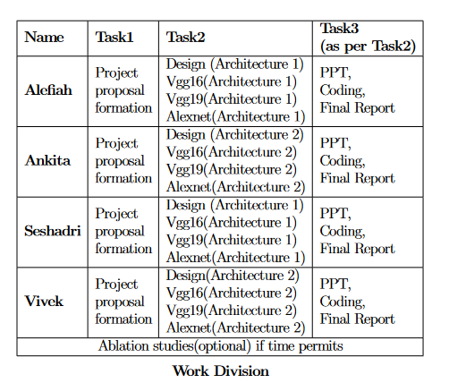
Work Divisions

Slide 24
Thank You
Alterant
- Alefiah Mubeen
- Ankita Maity
- Seshadri Mazumder
- Vivek Pareek

